Slide 1
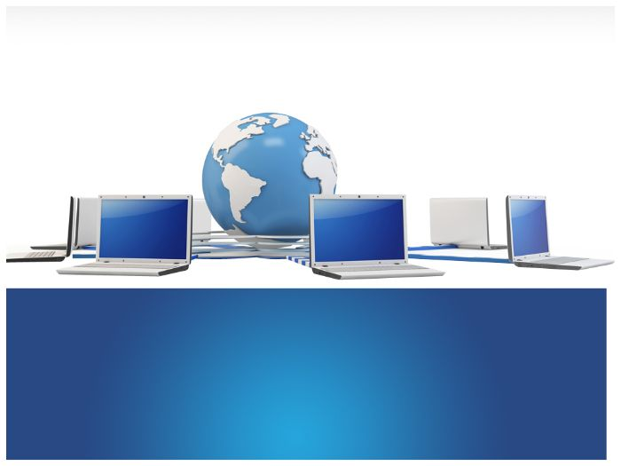
Computer Networks
By
Dr. Kanchan Shende

Slide 2
Module 1
Introduction to Computer Networks
Computer Networks -goals and applications
Data Communication
Data Flow
Networks : point-to-point connections, multipoint connections
Network topologies
Categories of Networks :LAN, WAN, MAN protocols and standards
SoCS, MIT-WPU

Slide 3
Computer Networks -goals and applications
Scope
Networking is everywhere
Network Support the way we learn.
Network support the way we communicate.
Networks support the we work.
Networks support the way we play
SoCS, MIT-WPU

Slide 4
Definition – Computer Network
Definition : A computer network is a set of nodes connected by communication links.
Node : A node can be a computer, printer or any other device capable of sending/receiving data generated by other nodes in the network.
Example : Computer, Server, Printer, Security Camera, Many more (Switches, Bridges, Routers etc.
SoCS, MIT-WPU

Slide 5
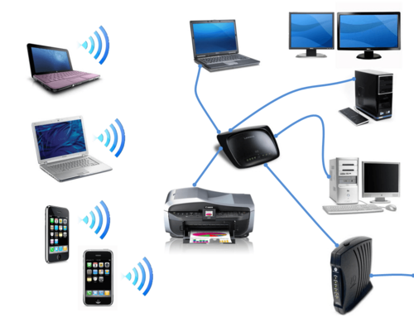
Conti….
Communication Links : A communication link can be a wired link or wireless link.
The link carries the information.
Example : Wired : Cable
Wireless: Air
SoCS, MIT-WPU

Slide 6
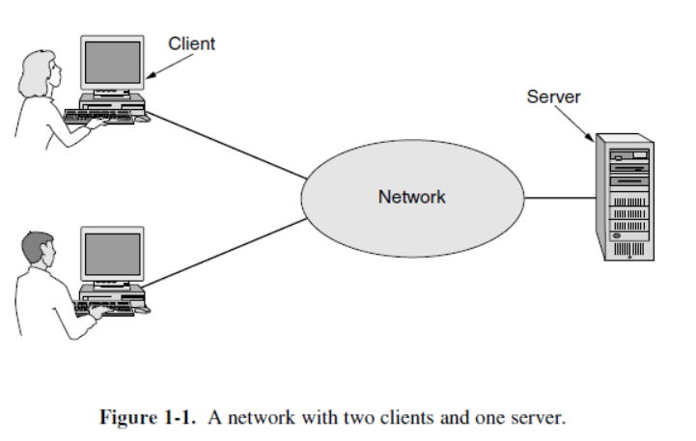
Computer Networks applications
Business Applications
SoCS, MIT-WPU

Slide 7
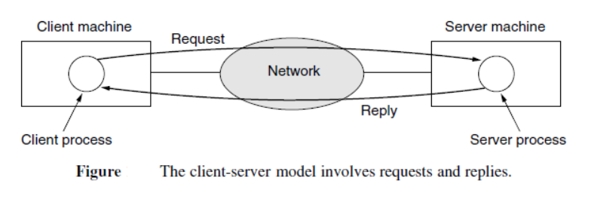
Conti…
SoCS, MIT-WPU

Slide 8
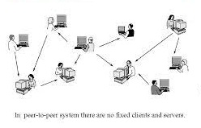
Conti…
Home Applications
SoCS, MIT-WPU

Slide 9
Basic Characteristics of Computer Networks
Fault Tolerance
Scalability
Quality of Service (QoS)
Security
SoCS, MIT-WPU

Slide 10
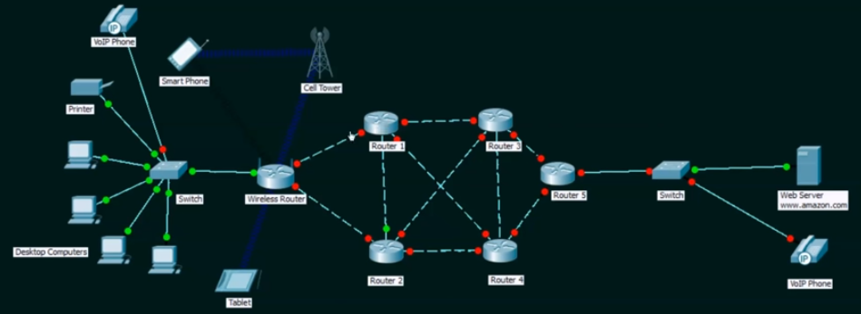
Conti…
Fault Tolerance
The ability to :
Continue working despite failures
Ensure no loss of service
SoCS, MIT-WPU

Slide 11
Conti…
Scalability
The ability to :
Grow based on the needs
Have good performance after growth
SoCS, MIT-WPU

Slide 12
Conti…
Quality of Service (QoS)
The ability to :
Set Priorities
Manage data traffic to reduce data loss, delay etc.,
SoCS, MIT-WPU

Slide 13
Conti…
Security
The ability to prevent
Unauthorized access
Misuse
Forgery
The ability to provide
Confidentiality
Integrity
Availability
SoCS, MIT-WPU

Slide 14
Data Communication
Data communications are the exchange of data between two devices via some form of transmission medium such as a wire cable or wireless.
For data communications to occur, the communicating devices must be part of a communication system made up of a combination of hardware (physical equipment) and software (programs).
SoCS, MIT-WPU

Slide 15
Conti…
The effectiveness of a data communications system depends on four fundamental characteristics: delivery, accuracy, timeliness, and jitter.
Delivery : The system must deliver data to the correct destination. Data must be received by the intended device or user and only by that device or user.
SoCS, MIT-WPU

Slide 16
Conti…
Accuracy : The system must deliver the data accurately. Data that have been altered in transmission and left uncorrected are unusable.
Timeliness : The system must deliver data in a timely manner. This kind of delivery is called real-time transmission.
SoCS, MIT-WPU

Slide 17
Data Communication
Jitter : Jitter refers to the variation in the packet arrival time. It is the uneven delay in the delivery of audio or video packets.
SoCS, MIT-WPU

Slide 18
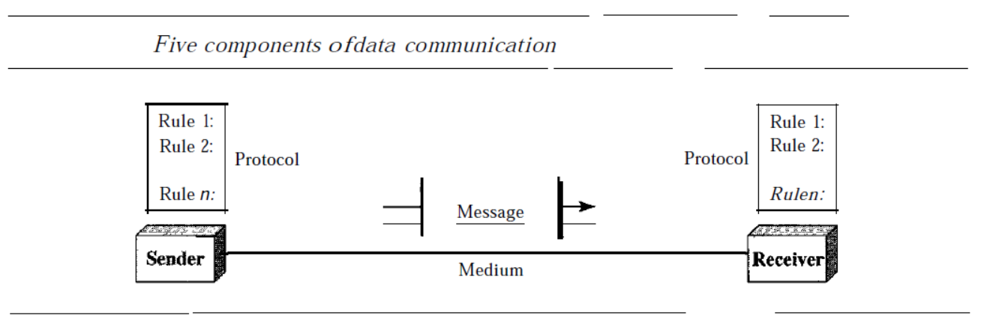
Conti…
A data communication system has five components :
SoCS, MIT-WPU

Slide 19
Conti…
Message : The message is the information (data) to be communicated. Popular forms of information include text, numbers, pictures, audio, and video.
Sender : The sender is the device that sends the data message. It can be a computer, workstation, telephone handset, video camera, and so on.
Receiver : The receiver is the device that receives the message. It can be a computer, workstation, telephone handset, television, and so on.
SoCS, MIT-WPU

Slide 20
Conti…
Transmission medium : The transmission medium is the physical path by which a message travels from sender to receiver. Some examples of transmission media include twisted-pair wire, coaxial cable, fiber-optic cable, and radio waves.
Protocol : A protocol is a set of rules that govern data communications. It represents an agreement between the communicating devices. Without a protocol, two devices may be connected but not communicating, just as a person speaking French cannot be understood by a person who speaks only Japanese.
SoCS, MIT-WPU

